Slide 1
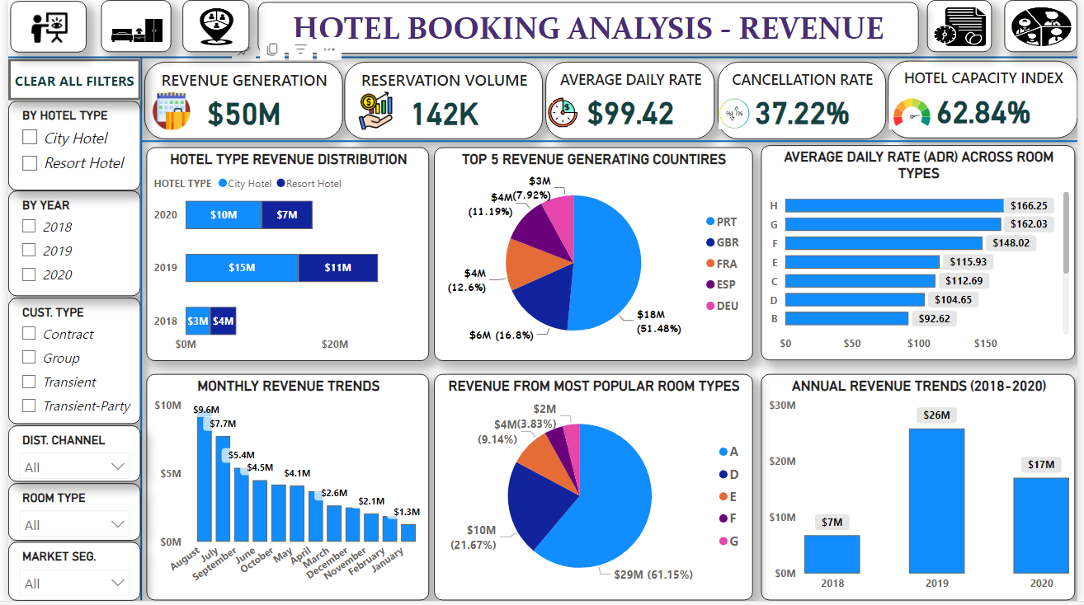



Hotel Booking analysis
View in Power BI
Last data refresh:
17-01-2024 07:27:17 UTC
Downloaded at:
18-01-2024 14:34:10 UTC

Slide 2
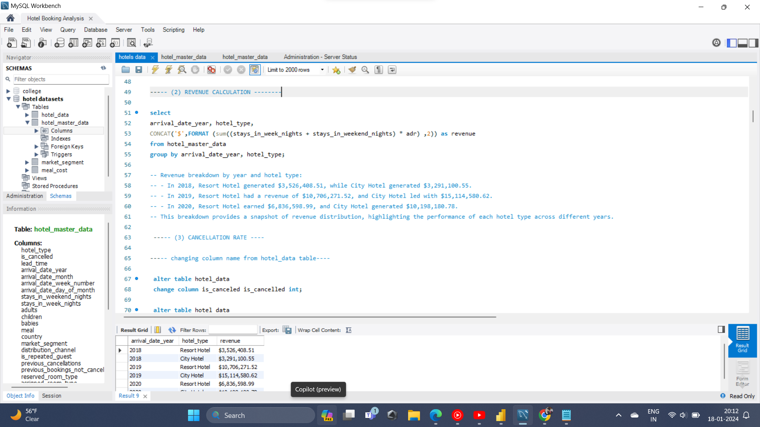

Slide 3
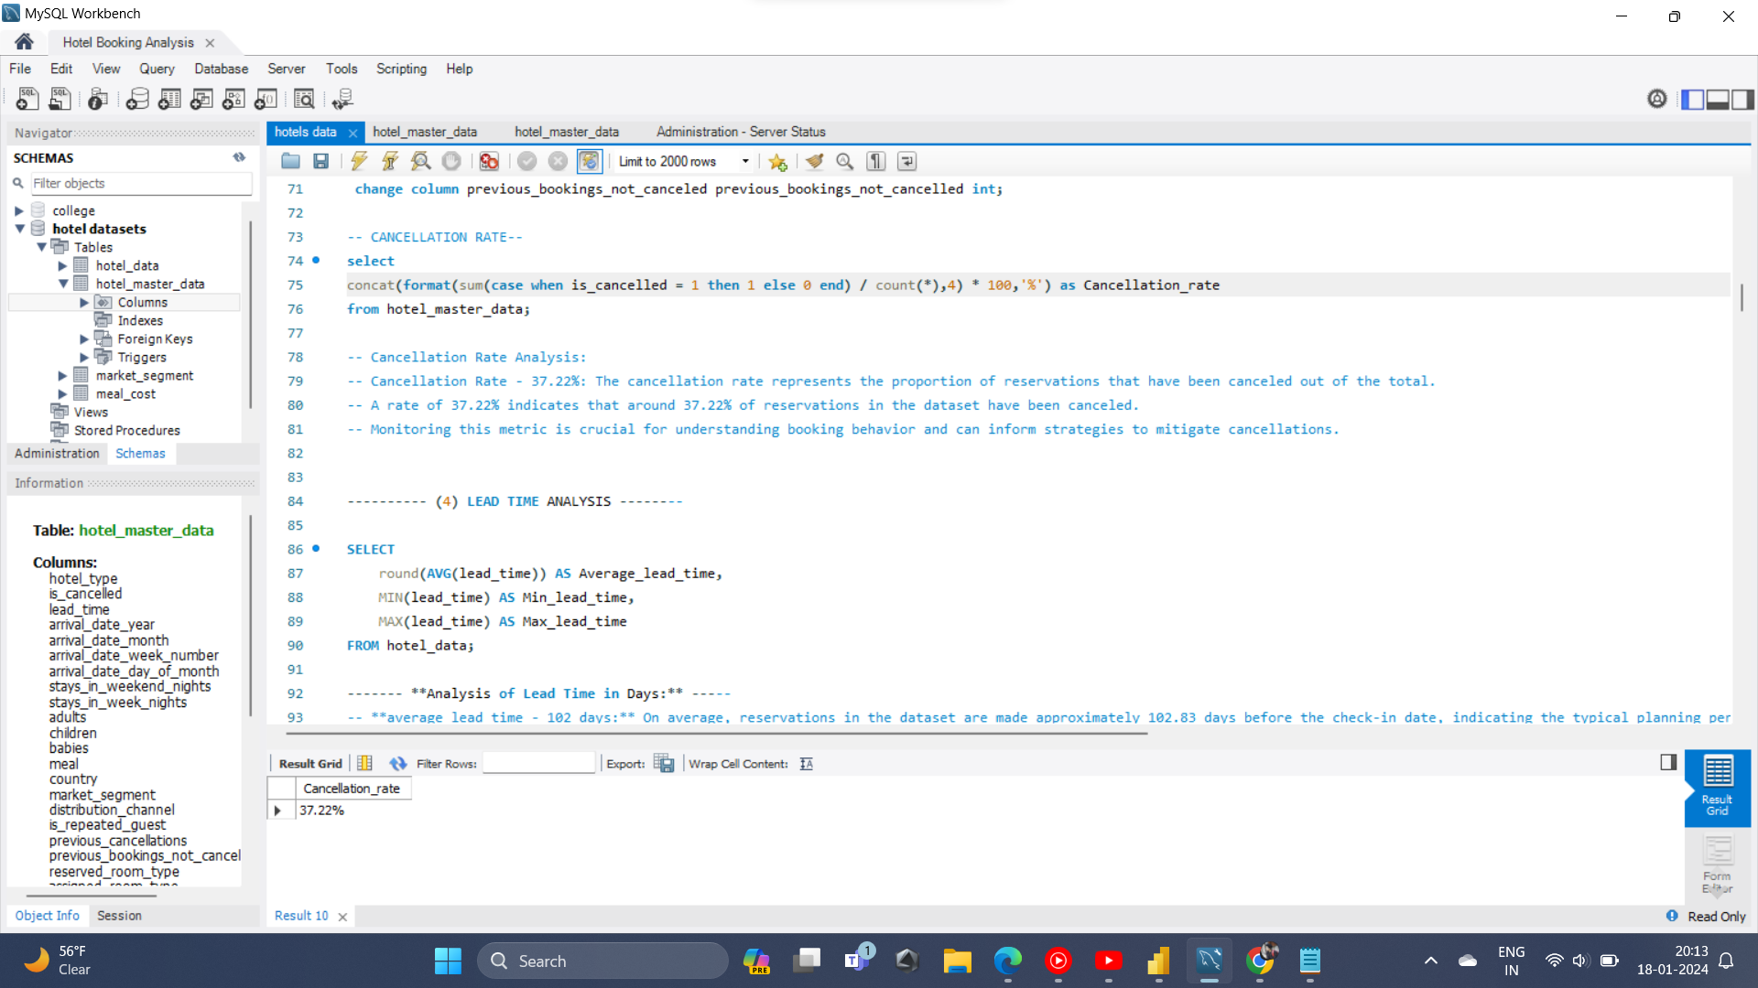

Slide 4
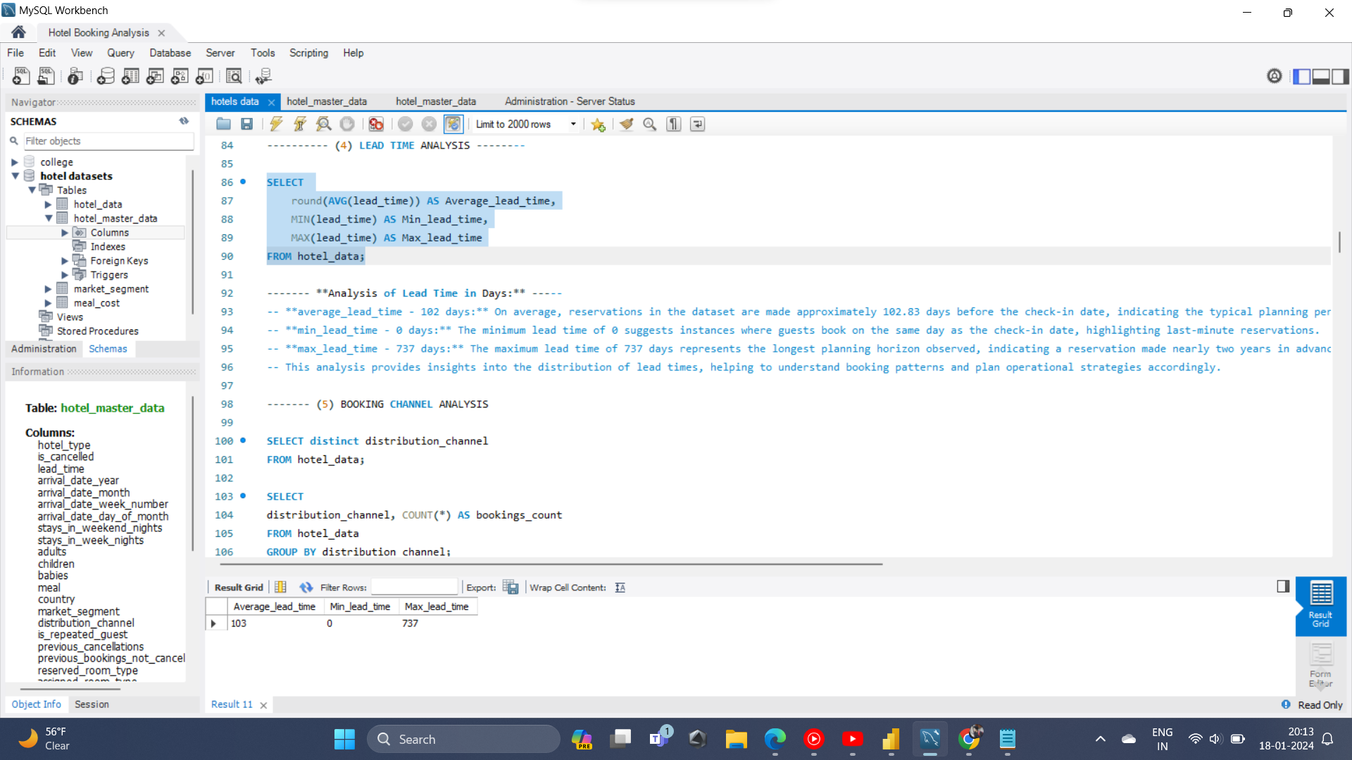

Slide 5
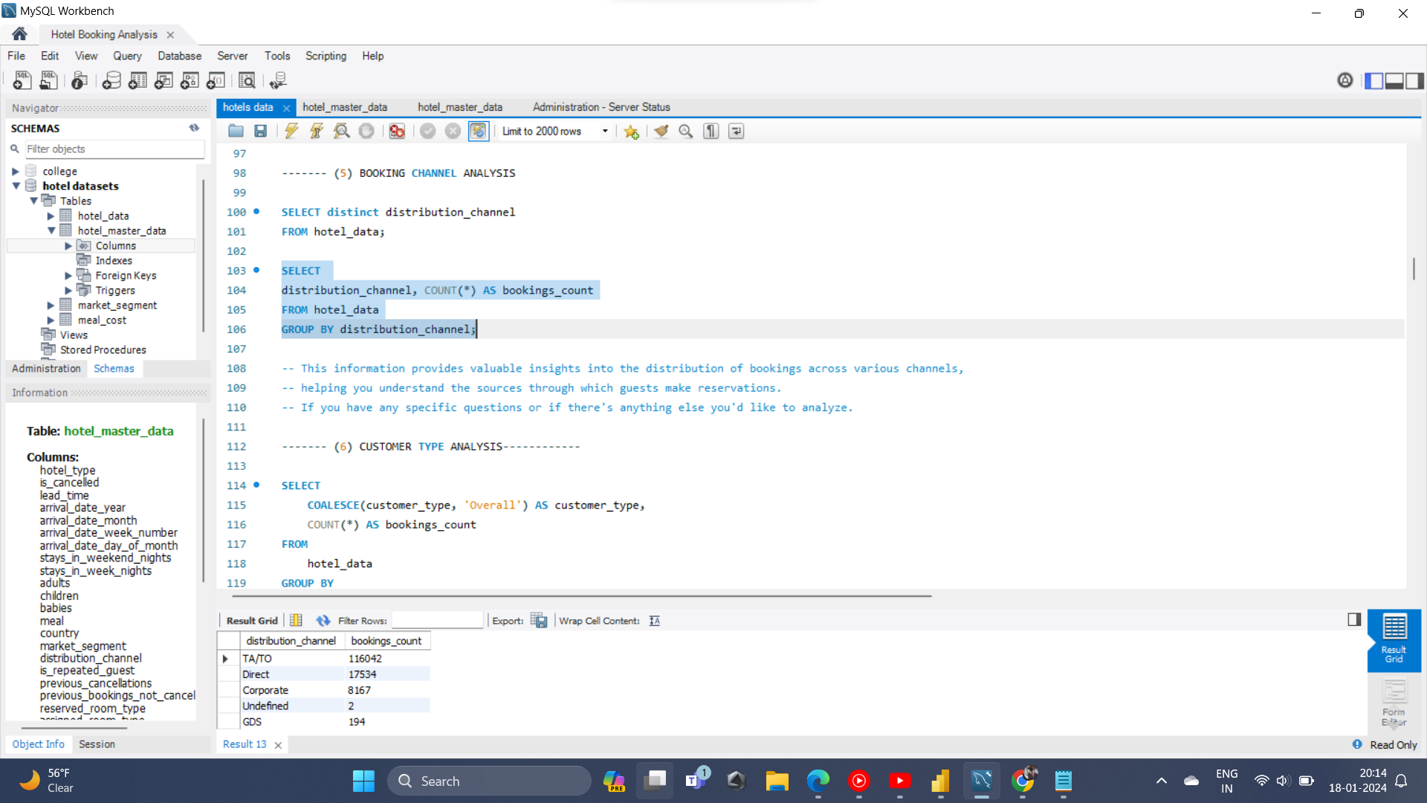

Slide 6
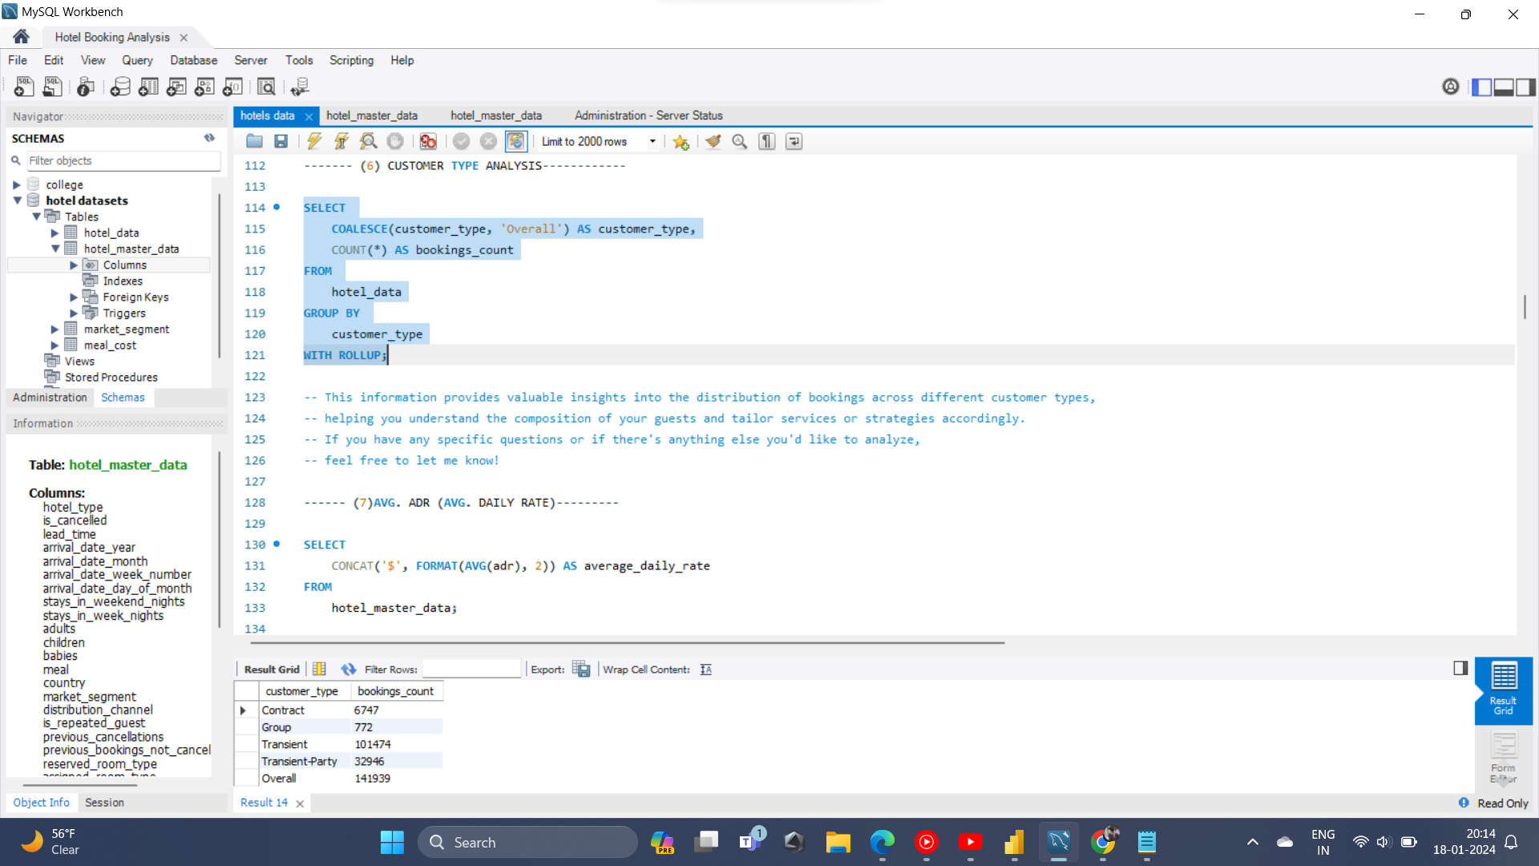

Slide 7
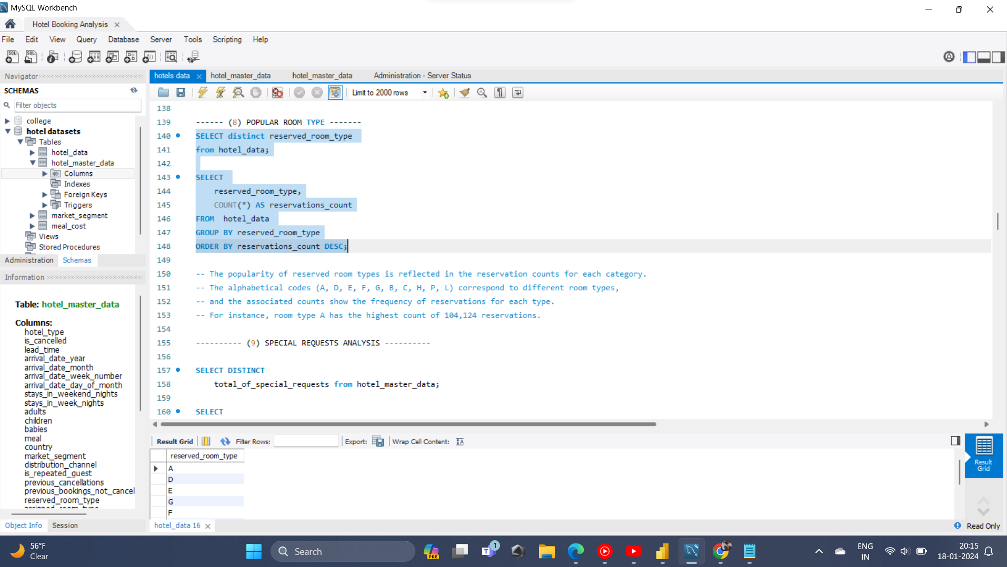

Slide 8
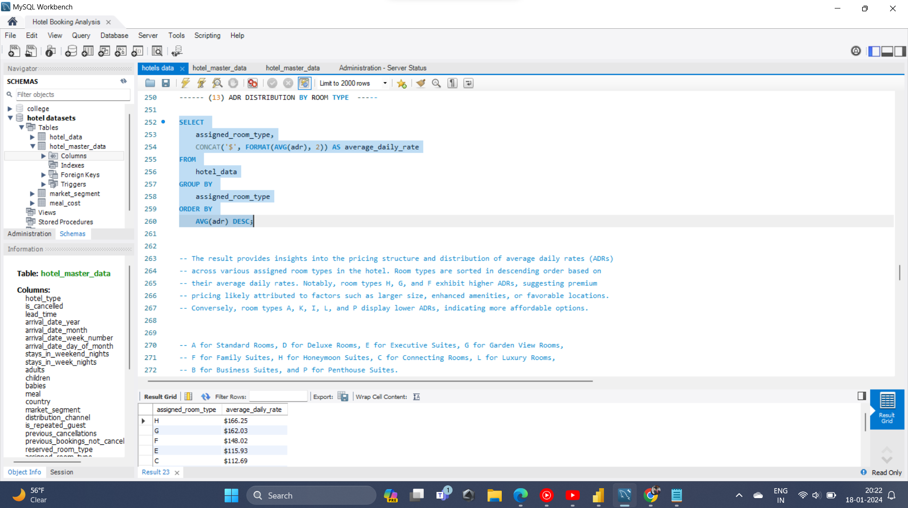

Slide 9
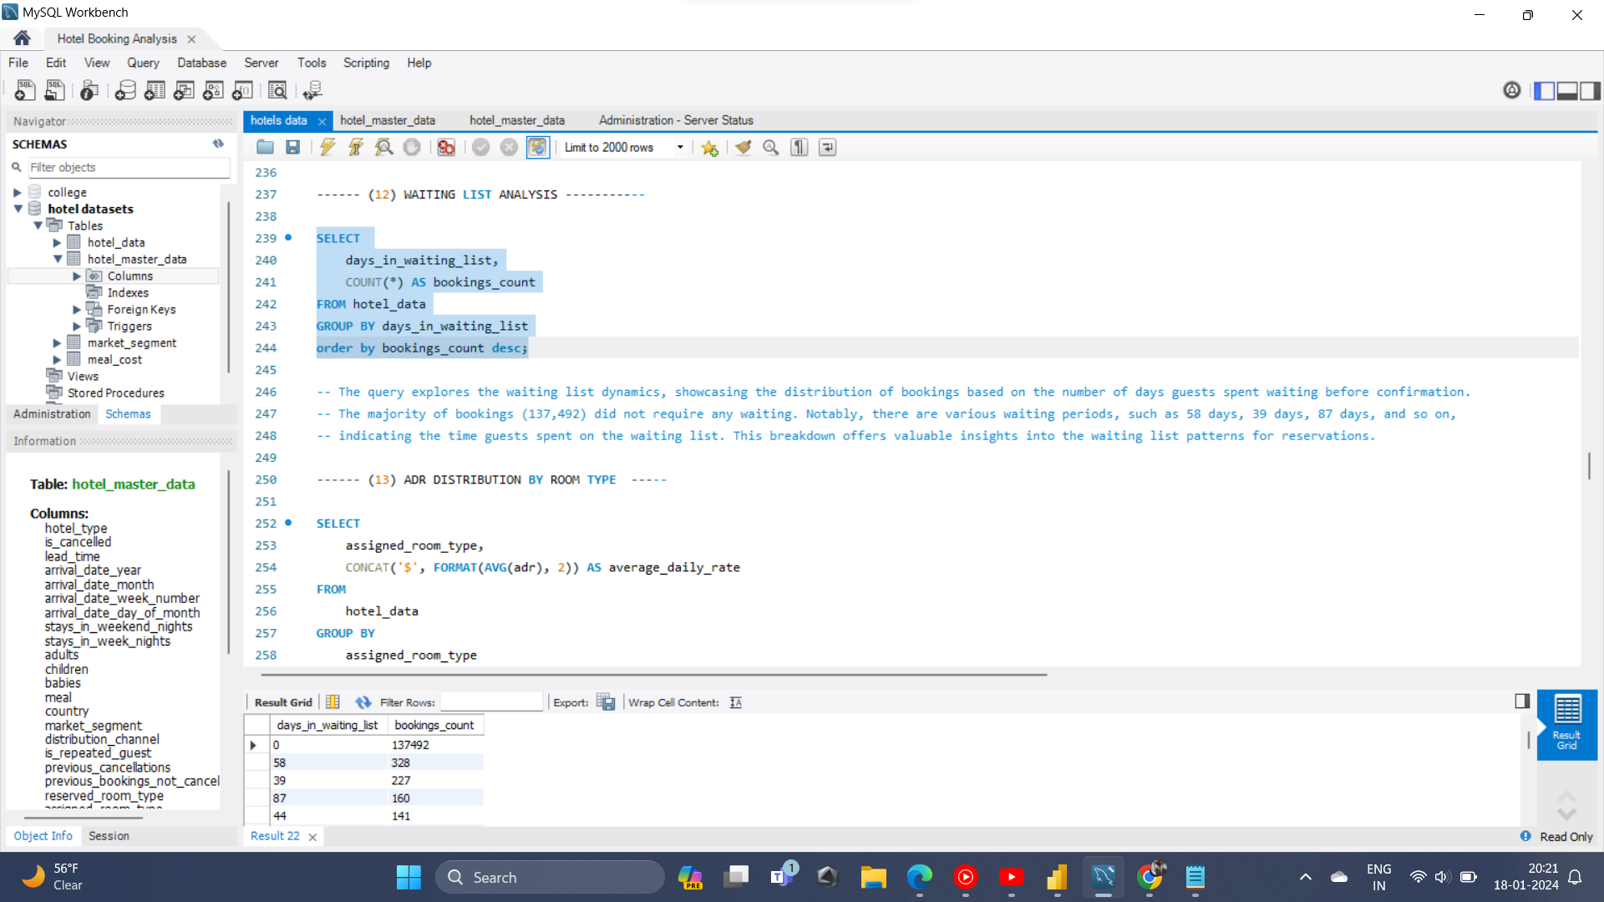

Slide 10
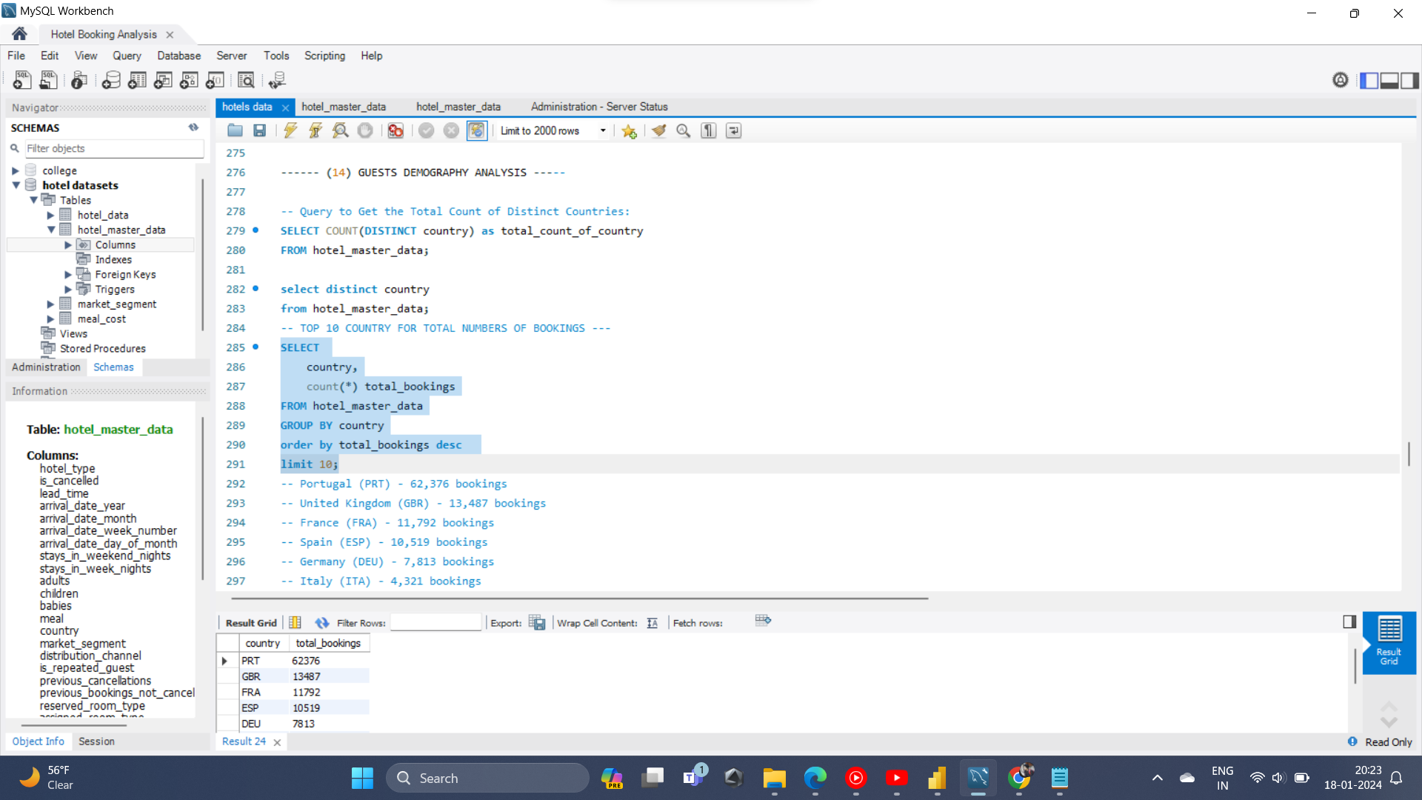

Slide 11
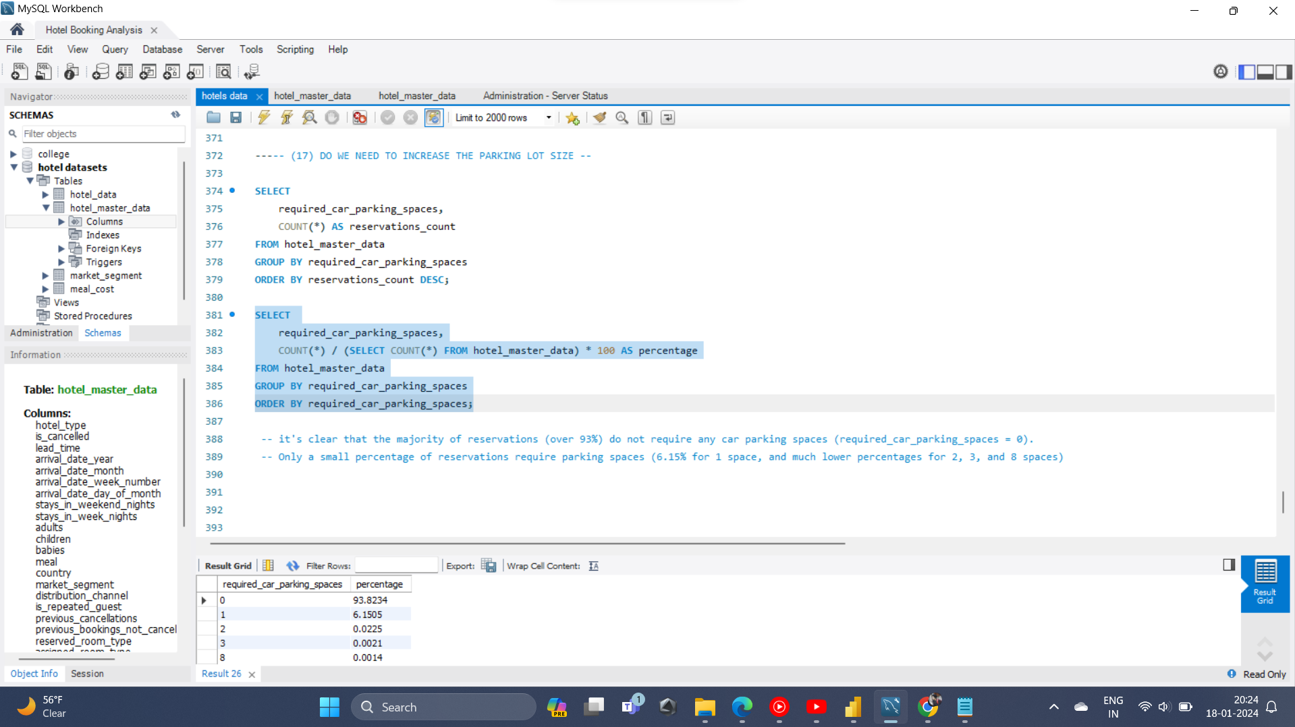

Slide 12
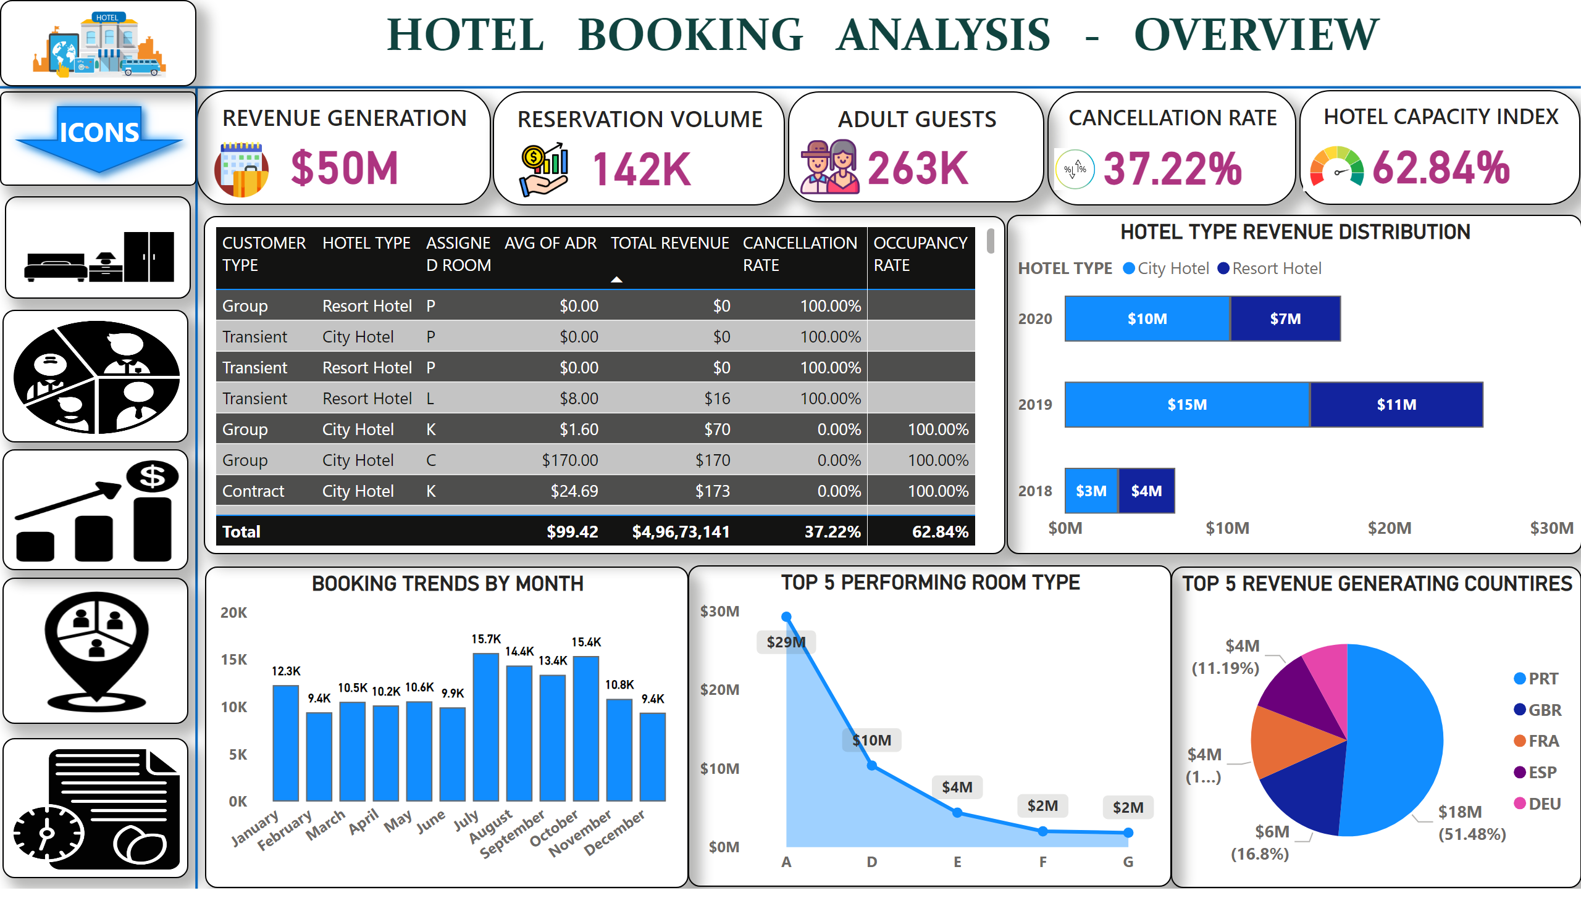
OVERVIEW
Notes:
image
No alt text provided
image
No alt text provided
image
No alt text provided
image
No alt text provided
REVENUE GENERATION
No alt text provided
RESERVATION VOLUME
No alt text provided
HOTEL CAPACITY INDEX
No alt text provided
CANCELLATION RATE
No alt text provided
TOP 5 REVENUE GENERATING COUNTIRES
No alt text provided
shape
No alt text provided
shape
No alt text provided
HOTEL TYPE REVENUE DISTRIBUTION
No alt text provided
TOP 5 PERFORMING ROOM TYPE
No alt text provided
BOOKING TRENDS BY MONTH
No alt text provided
tableEx
No alt text provided
image
No alt text provided
image
No alt text provided
ADULT GUESTS
No alt text provided
image
No alt text provided
image
No alt text provided
image
No alt text provided
textbox
No alt text provided
image
No alt text provided
shape
No alt text provided
image
No alt text provided

Slide 13
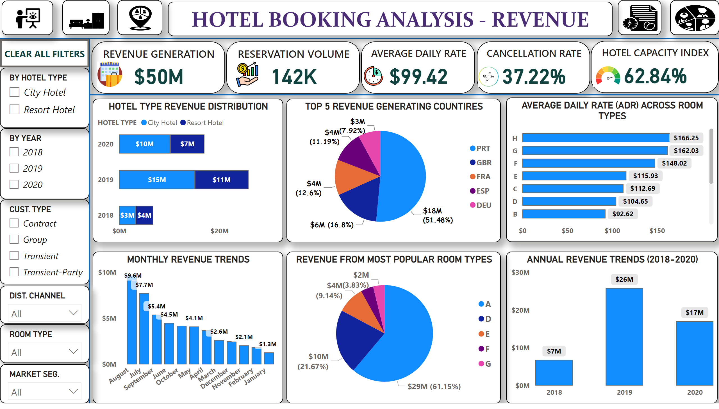
REVENUE
Notes:
shape
No alt text provided
textbox
No alt text provided
REVENUE GENERATION
No alt text provided
RESERVATION VOLUME
No alt text provided
AVERAGE DAILY RATE
No alt text provided
CANCELLATION RATE
No alt text provided
HOTEL CAPACITY INDEX
No alt text provided
slicer
No alt text provided
slicer
No alt text provided
slicer
No alt text provided
HOTEL TYPE REVENUE DISTRIBUTION
No alt text provided
shape
No alt text provided
MONTHLY REVENUE TRENDS
No alt text provided
ANNUAL REVENUE TRENDS (2018-2020)
No alt text provided
shape
No alt text provided
TOP 5 REVENUE GENERATING COUNTIRES
No alt text provided
REVENUE FROM MOST POPULAR ROOM TYPES
No alt text provided
AVERAGE DAILY RATE (ADR) ACROSS ROOM TYPES
No alt text provided
slicer
No alt text provided
slicer
No alt text provided
slicer
No alt text provided
image
No alt text provided
image
No alt text provided
image
No alt text provided
image
No alt text provided
CLEAR ALL FILTERS
No alt text provided
image
No alt text provided
image
No alt text provided
image
No alt text provided
image
No alt text provided
image
No alt text provided
image
No alt text provided

Slide 14
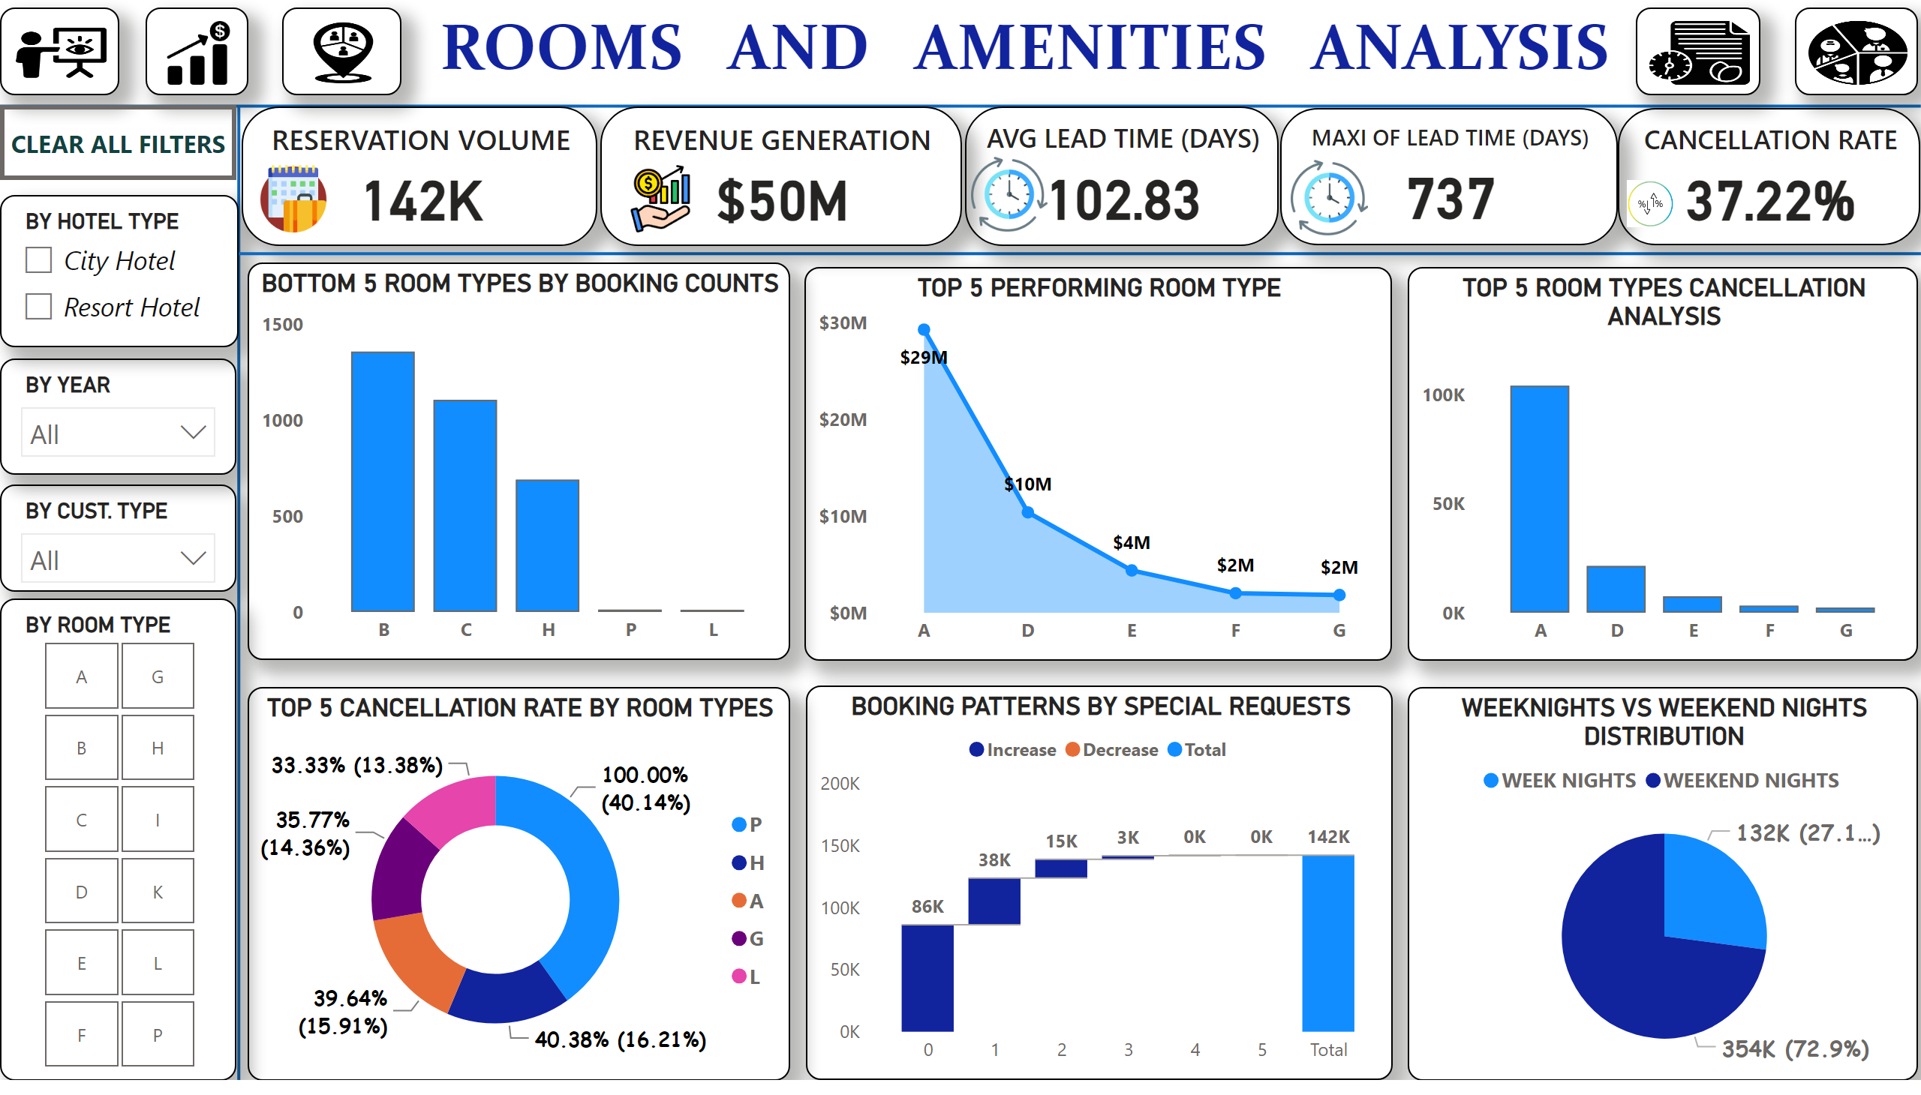
ROOMS & AMENITIES
Notes:
BOOKING PATTERNS BY SPECIAL REQUESTS
No alt text provided
shape
No alt text provided
shape
No alt text provided
slicer
No alt text provided
slicer
No alt text provided
slicer
No alt text provided
textbox
No alt text provided
TOP 5 PERFORMING ROOM TYPE
No alt text provided
RESERVATION VOLUME
No alt text provided
shape
No alt text provided
AVG LEAD TIME (DAYS)
No alt text provided
REVENUE GENERATION
No alt text provided
CANCELLATION RATE
No alt text provided
MAXI OF LEAD TIME (DAYS)
No alt text provided
TOP 5 CANCELLATION RATE BY ROOM TYPES
No alt text provided
BOTTOM 5 ROOM TYPES BY BOOKING COUNTS
No alt text provided
TOP 5 ROOM TYPES CANCELLATION ANALYSIS
No alt text provided
WEEKNIGHTS VS WEEKEND NIGHTS DISTRIBUTION
No alt text provided
image
No alt text provided
image
No alt text provided
image
No alt text provided
image
No alt text provided
image
No alt text provided
CLEAR ALL FILTERS
No alt text provided
slicer
No alt text provided
image
No alt text provided
image
No alt text provided
image
No alt text provided
image
No alt text provided
image
No alt text provided

Slide 15
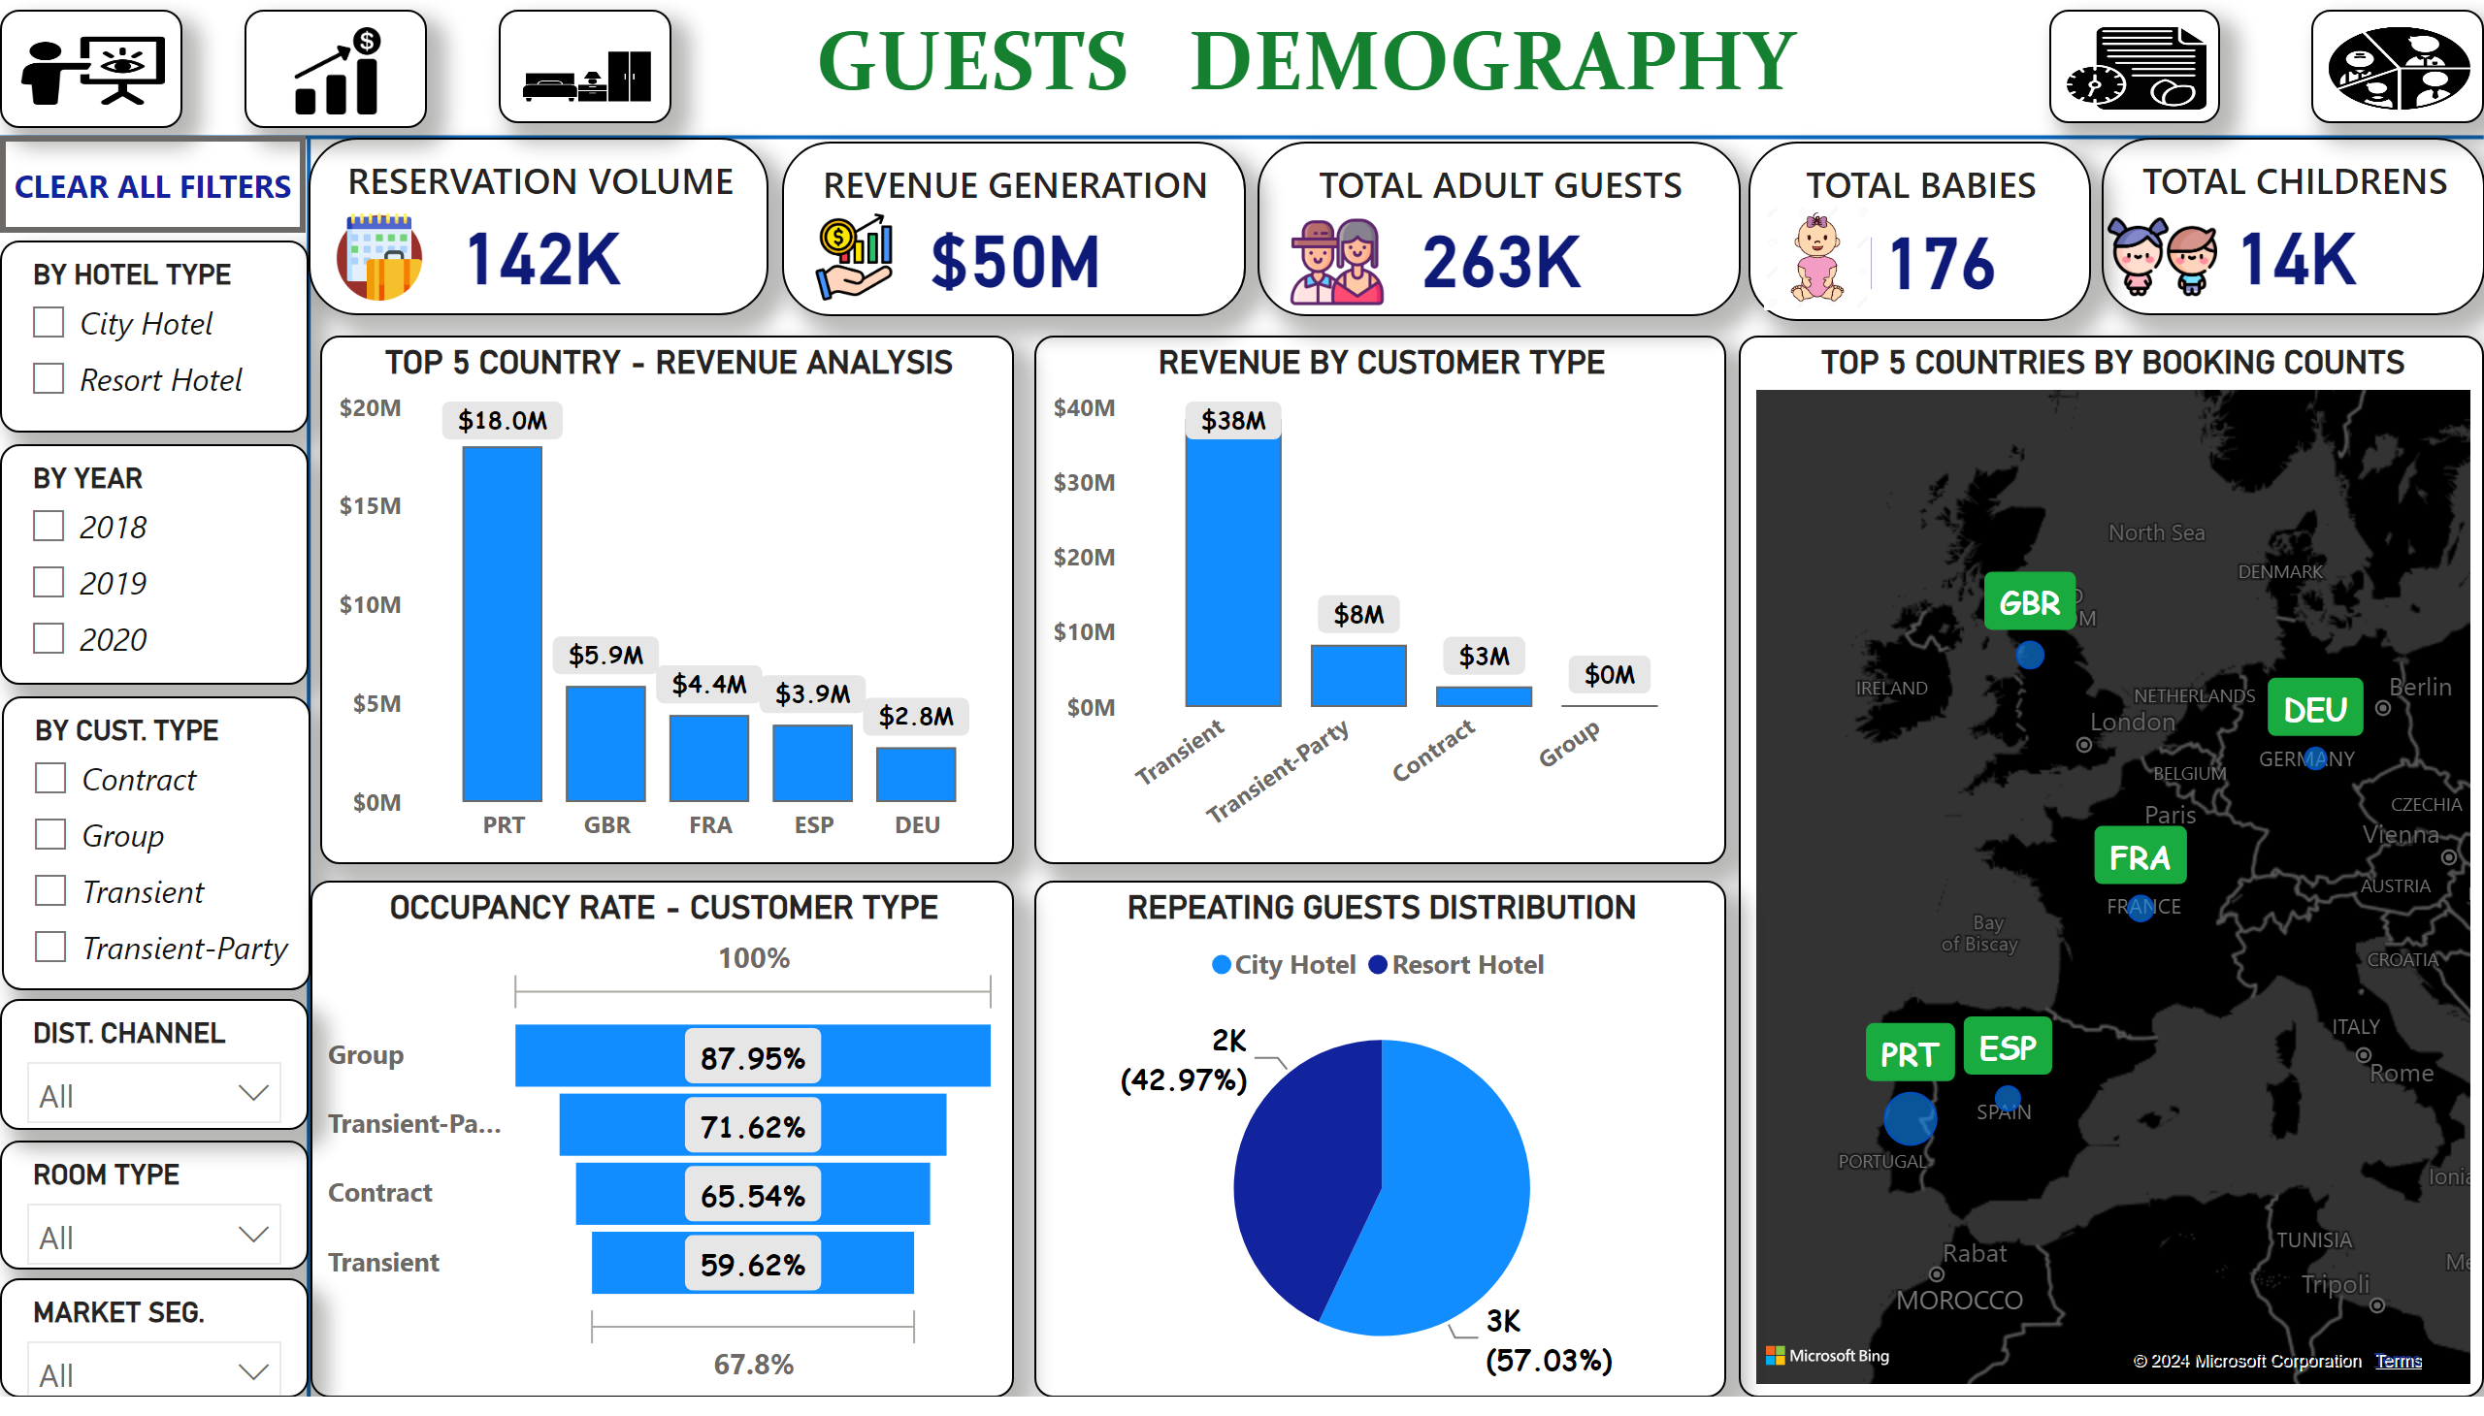
GUESTS DEMOGRAPHY
Notes:
REVENUE BY CUSTOMER TYPE
No alt text provided
shape
No alt text provided
shape
No alt text provided
slicer
No alt text provided
slicer
No alt text provided
slicer
No alt text provided
slicer
No alt text provided
textbox
No alt text provided
RESERVATION VOLUME
No alt text provided
TOTAL ADULT GUESTS
No alt text provided
TOTAL CHILDRENS
No alt text provided
TOTAL BABIES
No alt text provided
REVENUE GENERATION
No alt text provided
TOP 5 COUNTRIES BY BOOKING COUNTS
No alt text provided
REPEATING GUESTS DISTRIBUTION
No alt text provided
TOP 5 COUNTRY - REVENUE ANALYSIS
No alt text provided
OCCUPANCY RATE - CUSTOMER TYPE
No alt text provided
slicer
No alt text provided
slicer
No alt text provided
image
No alt text provided
image
No alt text provided
image
No alt text provided
image
No alt text provided
image
No alt text provided
CLEAR ALL FILTERS
No alt text provided
image
No alt text provided
image
No alt text provided
image
No alt text provided
image
No alt text provided
image
No alt text provided

Slide 16
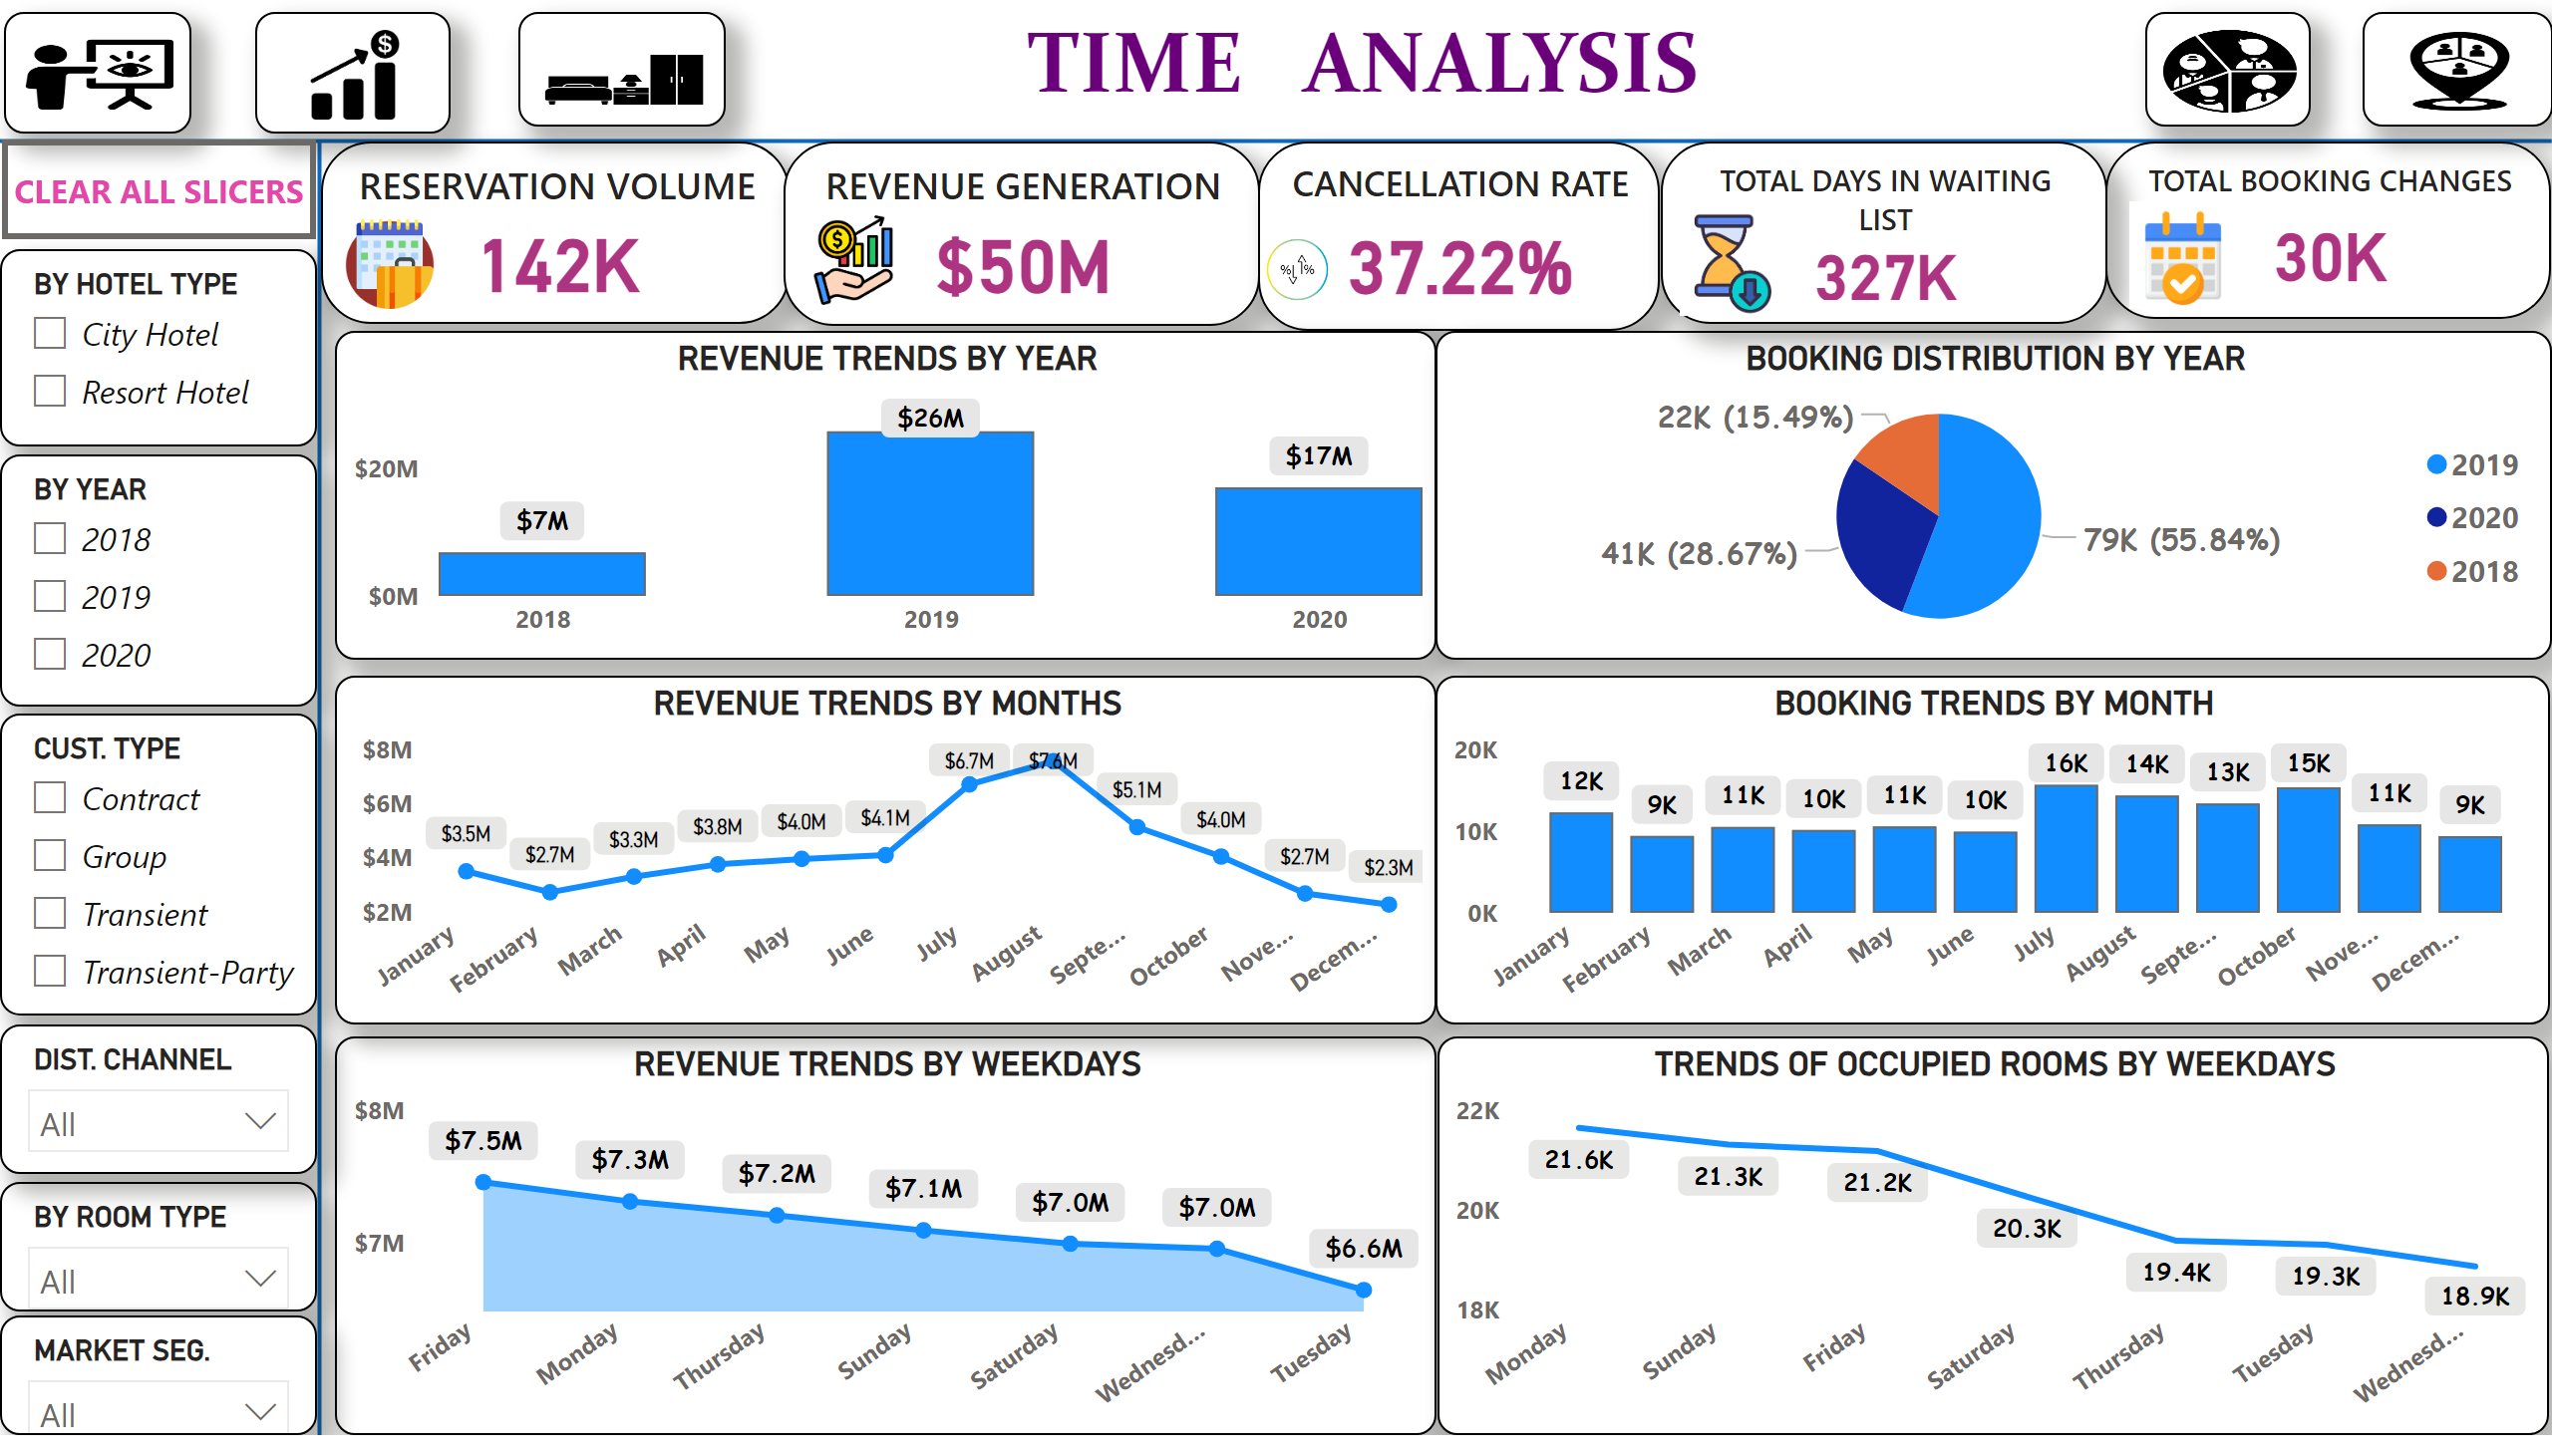
TIME ANALYSIS
Notes:
shape
No alt text provided
shape
No alt text provided
slicer
No alt text provided
slicer
No alt text provided
slicer
No alt text provided
slicer
No alt text provided
textbox
No alt text provided
RESERVATION VOLUME
No alt text provided
REVENUE GENERATION
No alt text provided
TOTAL BOOKING CHANGES
No alt text provided
CANCELLATION RATE
No alt text provided
REVENUE TRENDS BY YEAR
No alt text provided
REVENUE TRENDS BY WEEKDAYS
No alt text provided
BOOKING DISTRIBUTION BY YEAR
No alt text provided
REVENUE TRENDS BY MONTHS
No alt text provided
BOOKING TRENDS BY MONTH
No alt text provided
TRENDS OF OCCUPIED ROOMS BY WEEKDAYS
No alt text provided
TOTAL DAYS IN WAITING LIST
No alt text provided
slicer
No alt text provided
slicer
No alt text provided
image
No alt text provided
image
No alt text provided
image
No alt text provided
image
No alt text provided
image
No alt text provided
actionButton
No alt text provided
image
No alt text provided
image
No alt text provided
image
No alt text provided
image
No alt text provided
image
No alt text provided

Slide 17
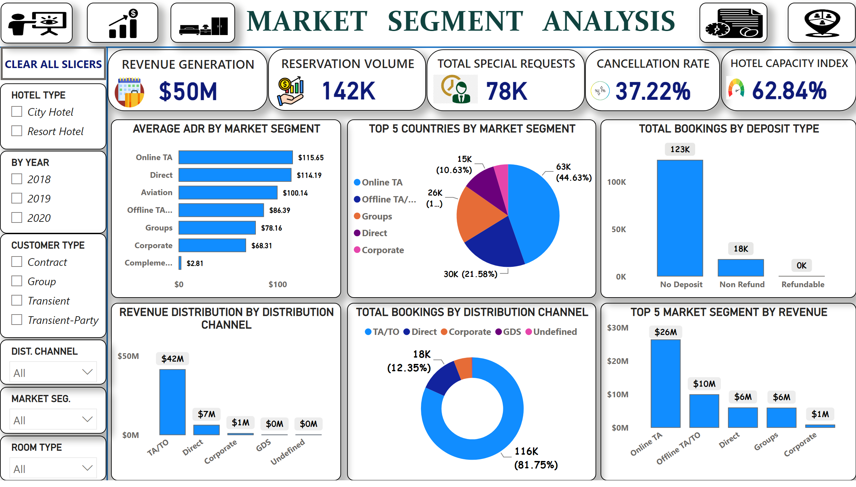
MARKET SEGMENT ANALYSIS
Notes:
TOP 5 MARKET SEGMENT BY REVENUE
No alt text provided
TOTAL BOOKINGS BY DISTRIBUTION CHANNEL
No alt text provided
shape
No alt text provided
shape
No alt text provided
slicer
No alt text provided
slicer
No alt text provided
slicer
No alt text provided
slicer
No alt text provided
REVENUE GENERATION
No alt text provided
RESERVATION VOLUME
No alt text provided
textbox
No alt text provided
TOP 5 COUNTRIES BY MARKET SEGMENT
No alt text provided
AVERAGE ADR BY MARKET SEGMENT
No alt text provided
REVENUE DISTRIBUTION BY DISTRIBUTION CHANNEL
No alt text provided
slicer
No alt text provided
slicer
No alt text provided
TOTAL SPECIAL REQUESTS
No alt text provided
TOTAL BOOKINGS BY DEPOSIT TYPE
No alt text provided
HOTEL CAPACITY INDEX
No alt text provided
CANCELLATION RATE
No alt text provided
image
No alt text provided
image
No alt text provided
image
No alt text provided
image
No alt text provided
image
No alt text provided
actionButton
No alt text provided
image
No alt text provided
image
No alt text provided
image
No alt text provided
image
No alt text provided
image
No alt text provided

